Slide 1
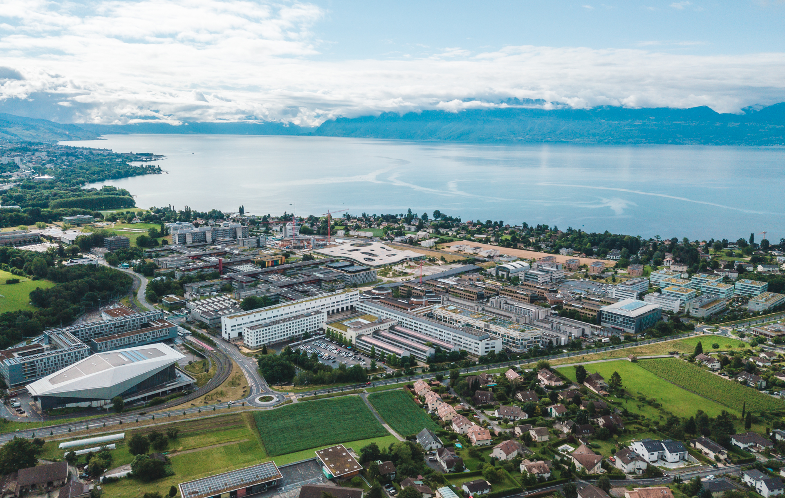
Antimicrobial resistance
Georges Barnikol
19.10.2023

Slide 2
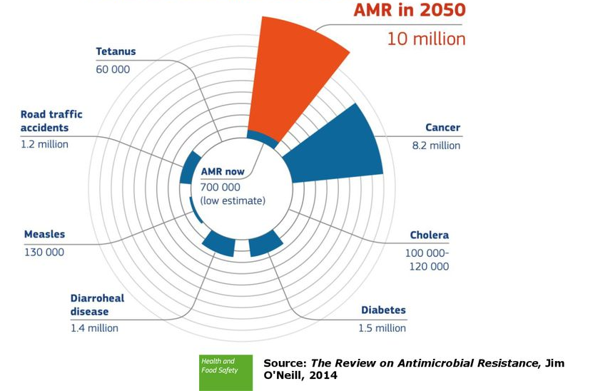
Issue of Anti Microbial Resistance (AMR)
Increase in mortality (at least 1.2 million and 5 million associated death in 2019)
Kill more people than HIV/AIDS
Routine procedure will be riskier
Economical loss (1.5 billion € each year in EU)
Murray, C. J. L. et al. Global burden of bacterial antimicrobial resistance in 2019: a systematic analysis. The Lancet 399, 629–655 (2022).

Slide 3
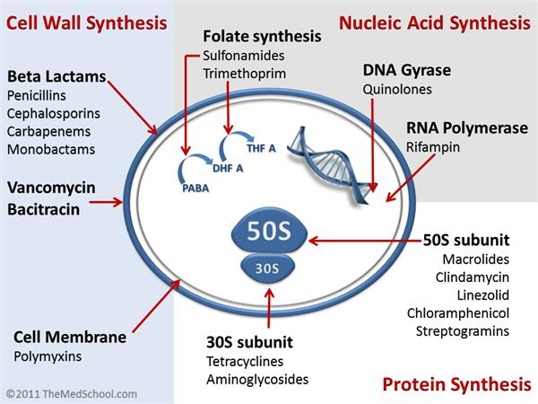
Different targets
Adel, M. & Dawood, M. A. O. Probiotics Application: Implications for Sustainable Aquaculture. in Probiotic Bacteria and Postbiotic Metabolites: Role in Animal and Human Health (eds. Mojgani, N. & Dadar, M.) 191–219 (Springer, 2021).

Slide 4
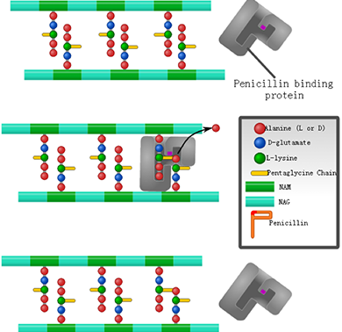
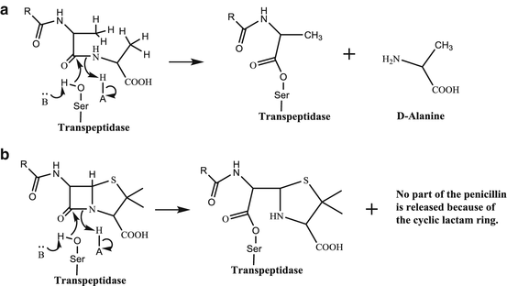
PBP mechanism and inactivation
Normal substrate
Antibiotic
Bhattacharjee, M. K. Antibiotics That Inhibit Cell Wall Synthesis. in Chemistry of Antibiotics and Related Drugs (ed. Bhattacharjee, M. K.) 49–94 (Springer International Publishing, 2016).
Notes:
Thiazolidine ring give steric hinderance for the second peptide to react

Slide 5
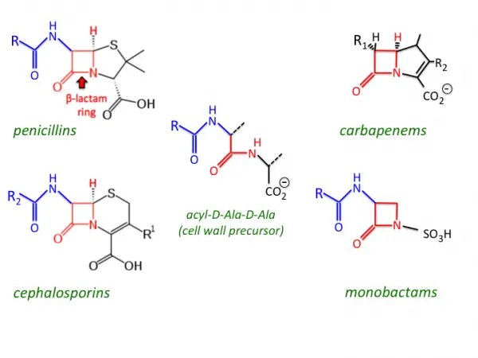
Antibiotic design
Penicillin Binding Protein (PBP) binds to D-Ala-D-Ala motif to link cell wall
β-lactam antibiotics mimic the structure of D-Ala-D-Ala recognised by PBP
Bhattacharjee, M. K. Antibiotics That Inhibit Cell Wall Synthesis. in Chemistry of Antibiotics and Related Drugs (ed. Bhattacharjee, M. K.) 49–94 (Springer International Publishing, 2016).

Slide 6
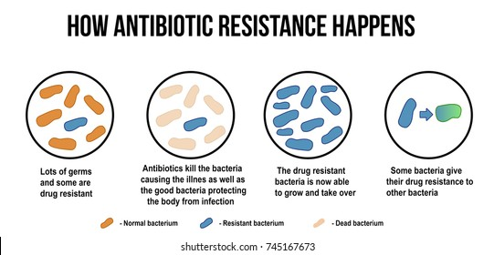
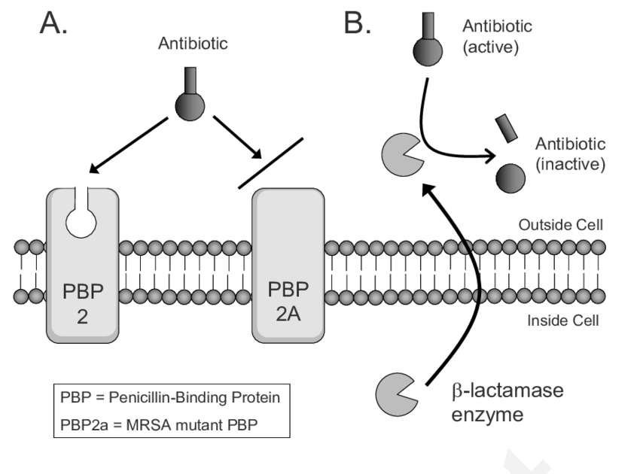
Murphy, J. T. & Walshe, R. Modeling Antibiotic Resistance in Bacterial Colonies Using Agent-Based Approach. in Understanding the Dynamics of Biological Systems: Lessons Learned from Integrative Systems Biology (eds. Dubitzky, W., Southgate, J. & Fuß, H.) 131–154 (Springer, 2011).

Slide 7
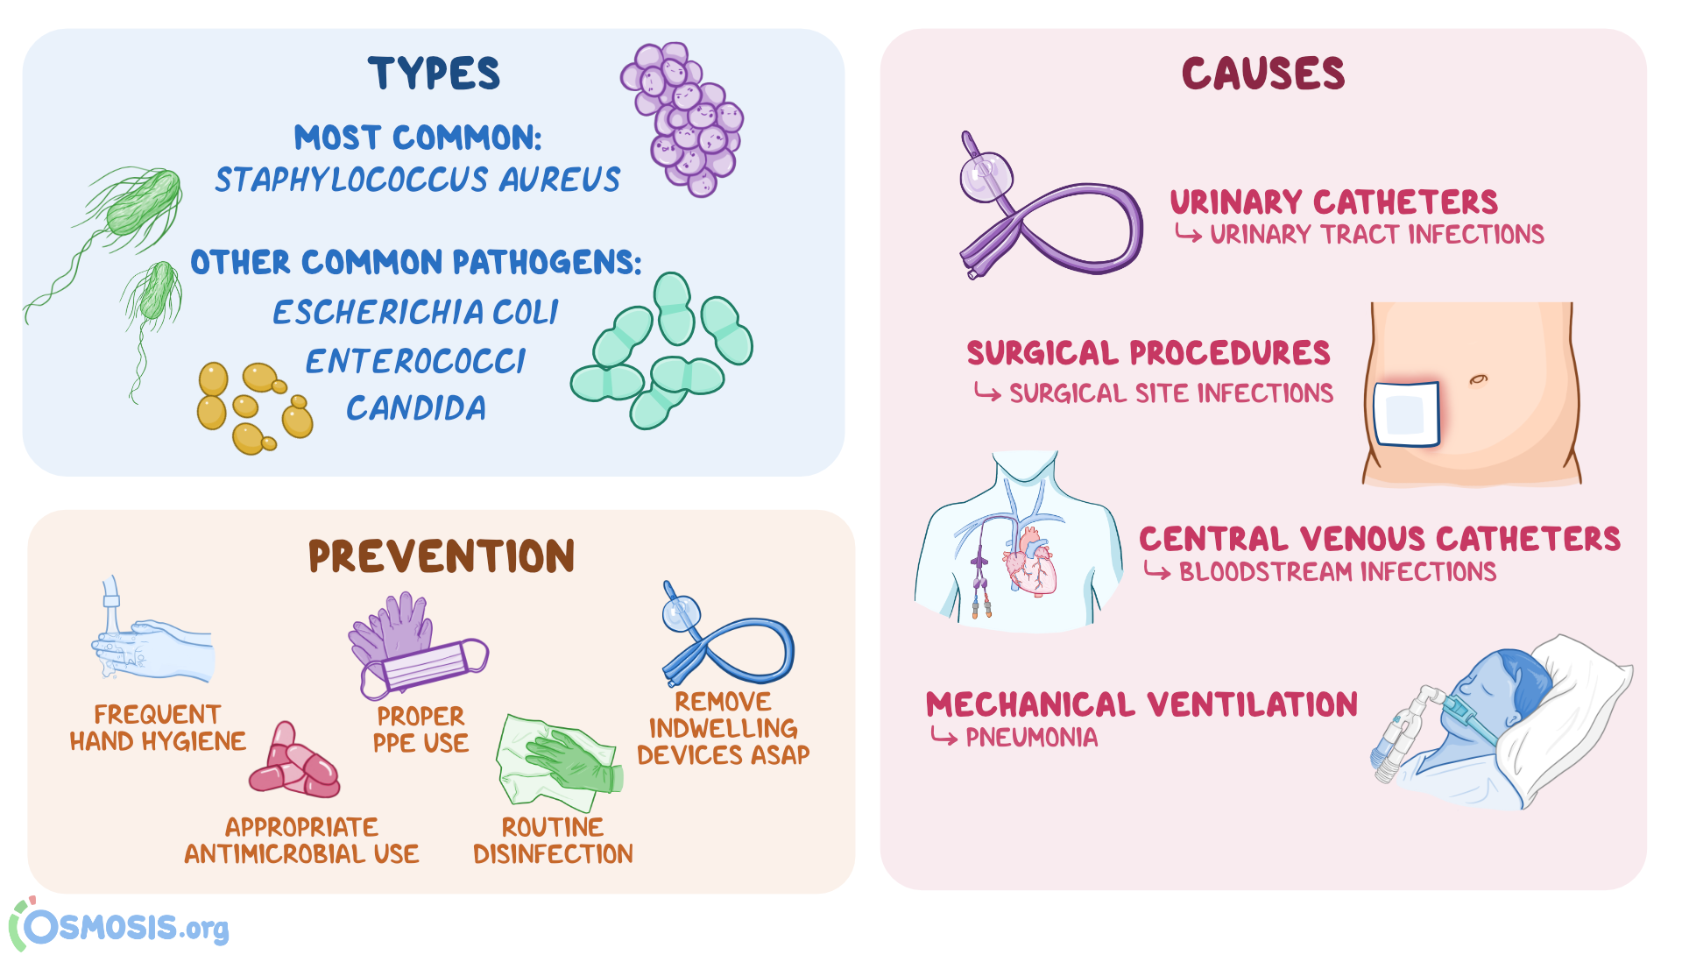

Nosocomial infections
Acinetobacter baumannii
Nosocomial Infection: What Is It, Causes, Prevention, and More | Osmosis. https://www.osmosis.org/answers/nosocomial-infection.
Notes:
Acinetobacter baumannii for burn victims

Slide 8
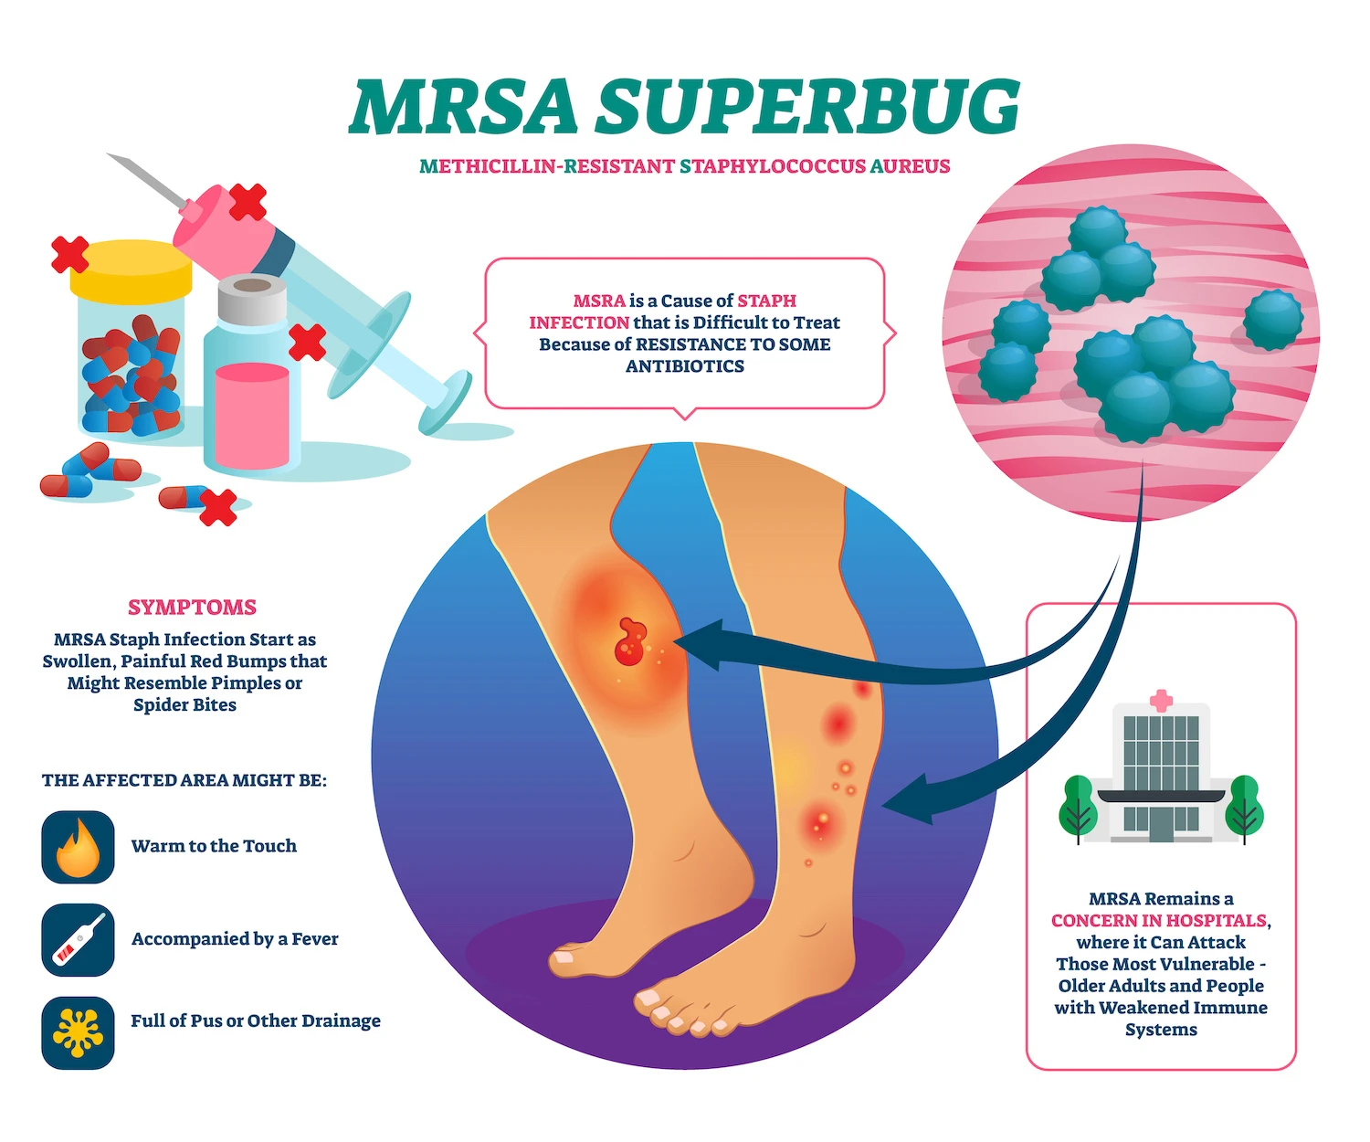
∼ 15% of population are carrier of S. Aureus
70% of population are occasionnal carrier
https://berberianain.com/mrsa-infections-nursing-homes/

Slide 9
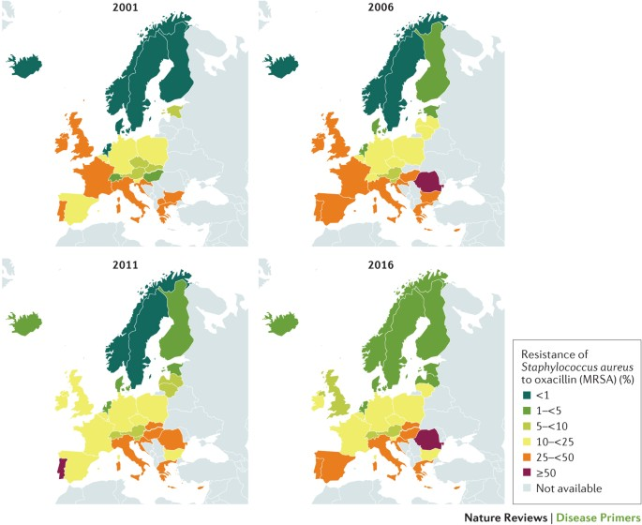
MRSA prevalence
MRSA caused 100,000 deaths in 2019
Lee, A. S. et al. Methicillin-resistant Staphylococcus aureus. Nat. Rev. Dis. Primer 4, 1–23 (2018)

Slide 10
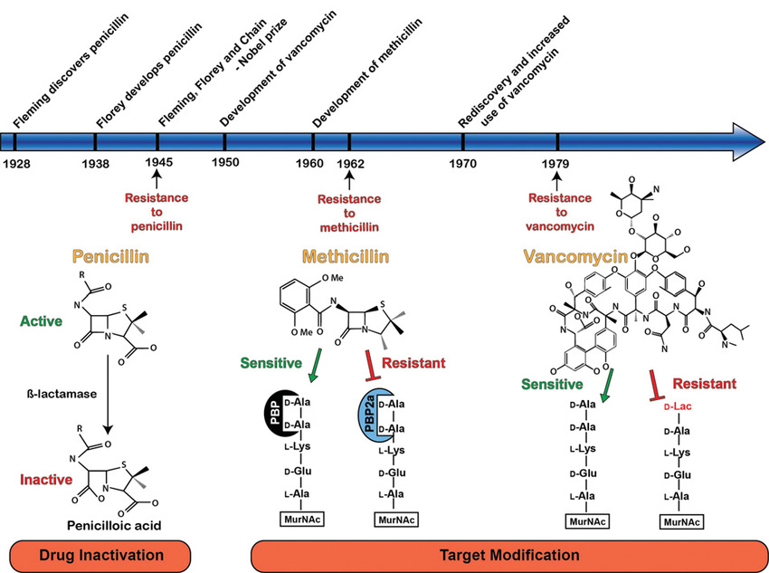
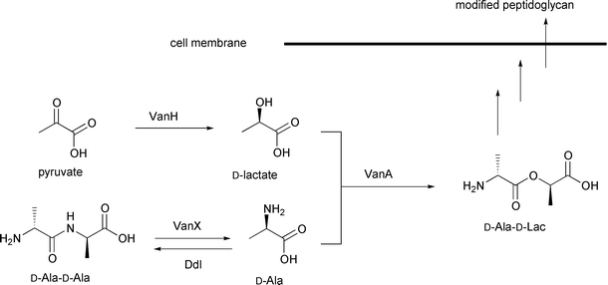
Used Antibiotics against S. Aureus
Venter, H., Henningsen, M. L. & Begg, S. L. Antimicrobial resistance in healthcare, agriculture and the environment: the biochemistry behind the headlines. Essays Biochem. 61, 1–10 (2017).
Notes:
Lac : Ala analogue O instead of the amine group

Slide 11
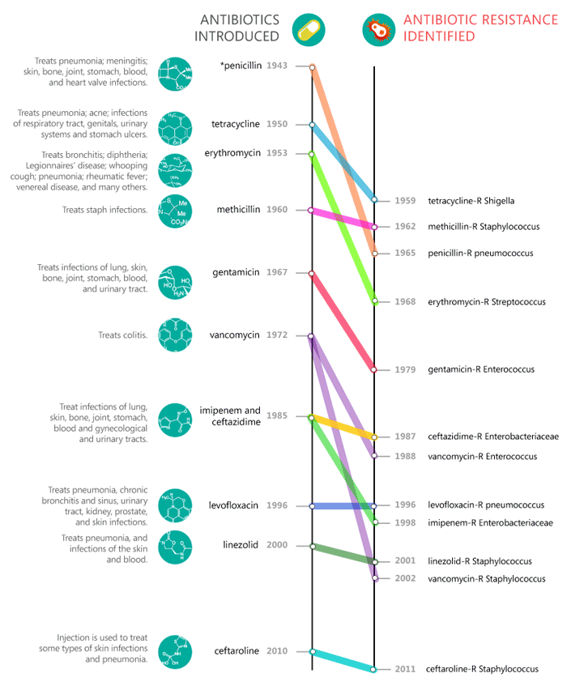
Why are new antibiotic not developped ?
High development cost
Low return of investment
Resistant strain develops rapidly
Need of constant antibiotic development
Need of new therapeutic means
Need of investment for developping new antibiotic
Graham, C. J. The global threat of antibiotic resistance: what can be done? J. Glob. Health Rep. 1, e2017002 (2017)

Slide 12
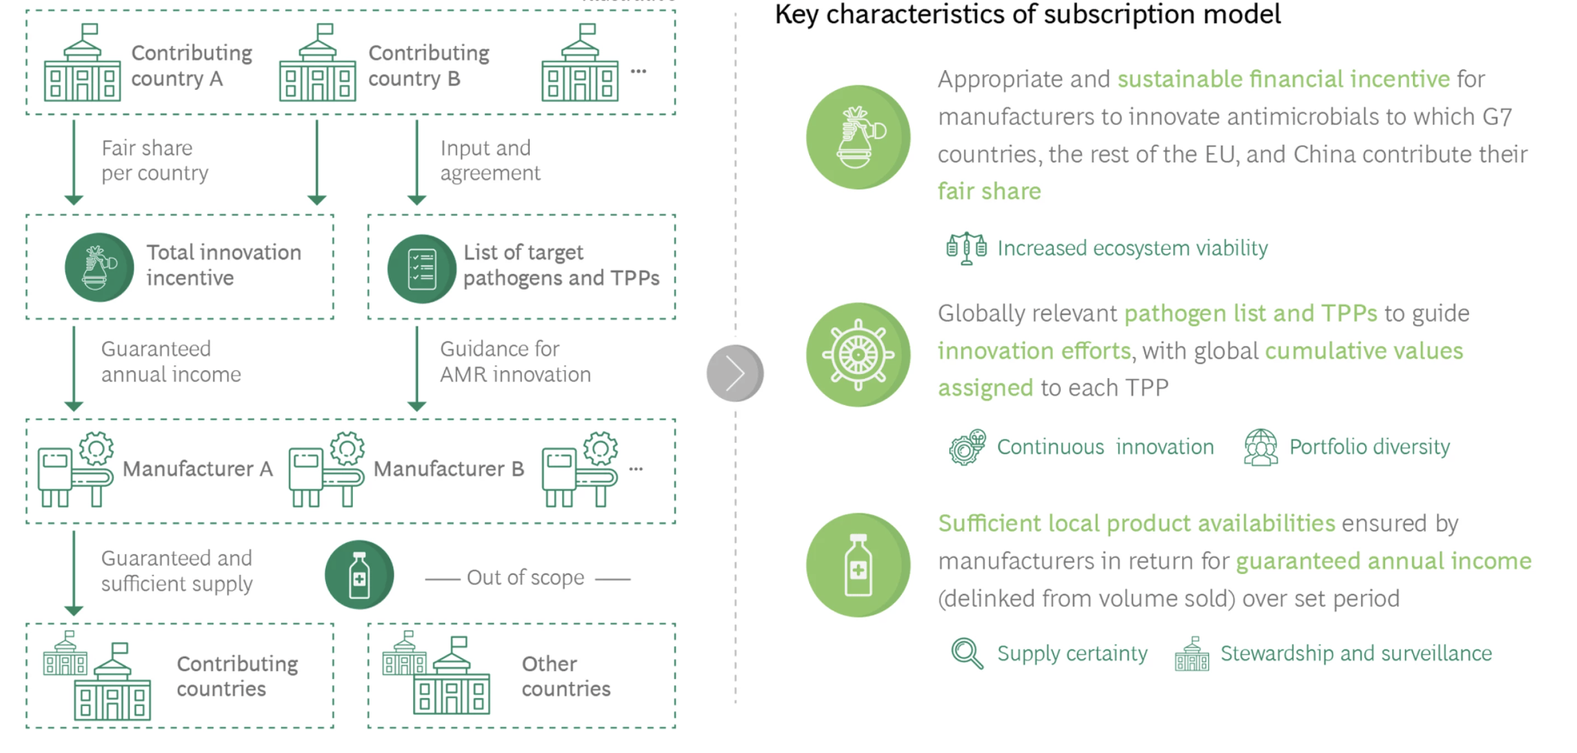
Subscription model

Slide 13
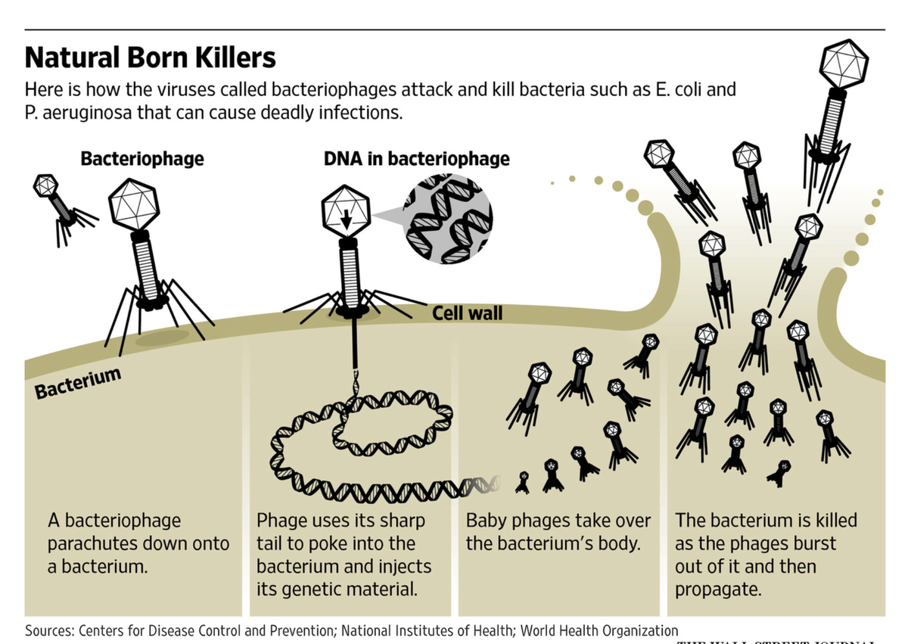
Phage Therapy
The enemy of my enemy is my friend
Narrow spectrum
’Fast’ to develop
Already used in Eastern country (Russia, Georgia,…)
Not yet FDA approved (last resort treatment)
https://medium.com/@veda.bhattaram/what-is-antibiotic-resistance-and-how-phage-therapy-could-solve-it-32fffd36ad58

Slide 14
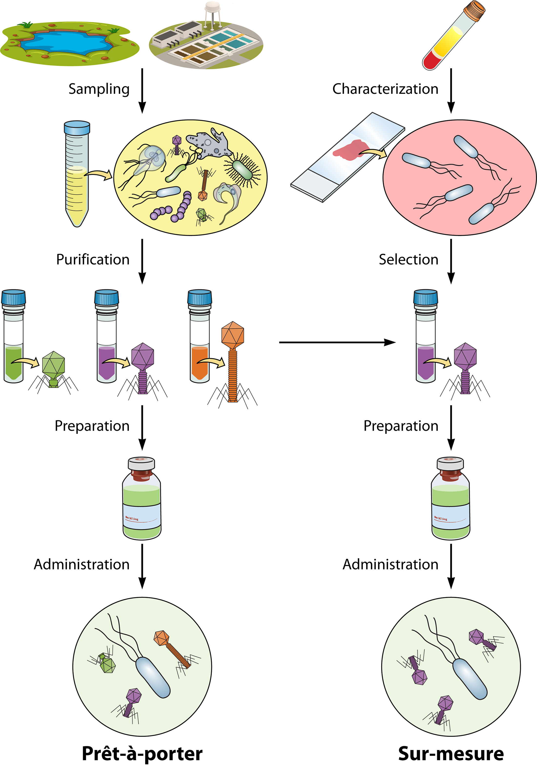
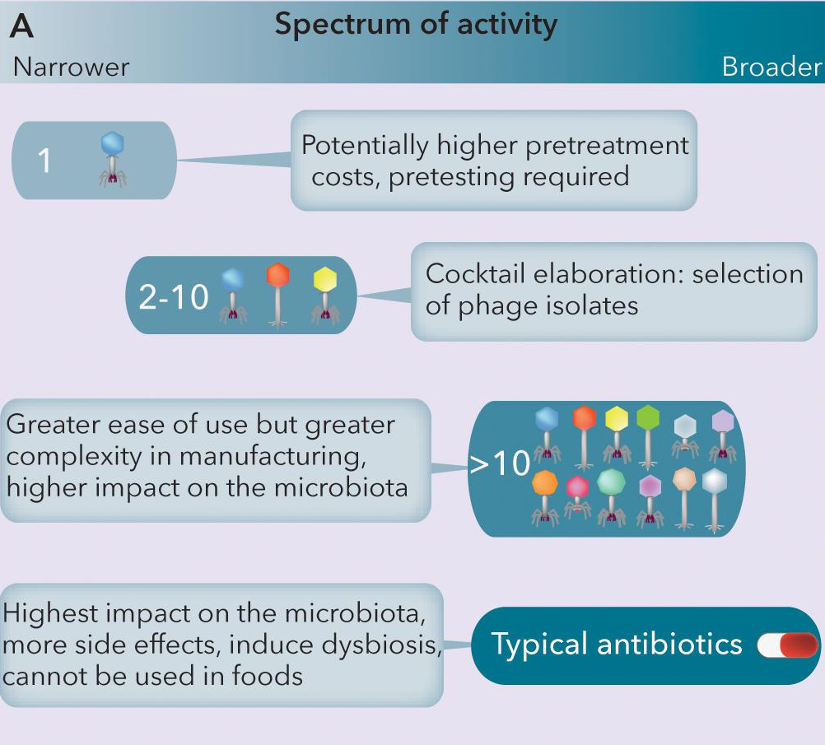
Molina, F. et al. A New Pipeline for Designing Phage Cocktails Based on Phage-Bacteria Infection Networks. Front. Microbiol. 12, 564532 (2021).
Loc-Carrillo, C. & Abedon, S. T. Pros and cons of phage therapy. Bacteriophage 1, 111–114 (2011).

Slide 15
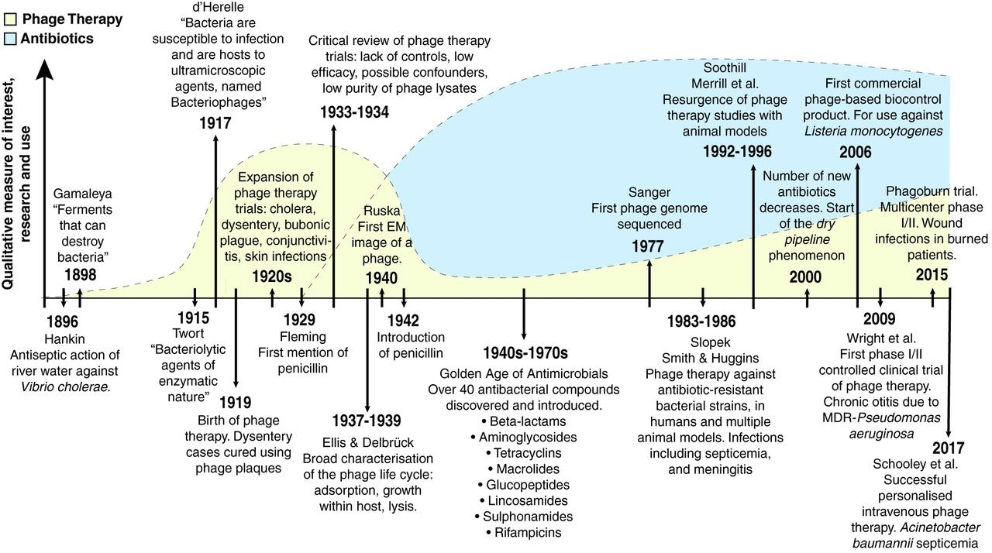
Gordillo Altamirano FL, Barr JJ. Phage Therapy in the Postantibiotic Era. Clin Microbiol Rev. 2019 Jan 16;32(2):e00066-18.

Slide 16
Why phage therapy is not yet approved ?
Phage is a living species
Pharmacology is not yet totally understood
Narrow spectrum need to combine them to be effective
Human immune system ?
FDA procedure not adapted
Loc-Carrillo, C. & Abedon, S. T. Pros and cons of phage therapy. Bacteriophage 1, 111–114 (2011).

Slide 17
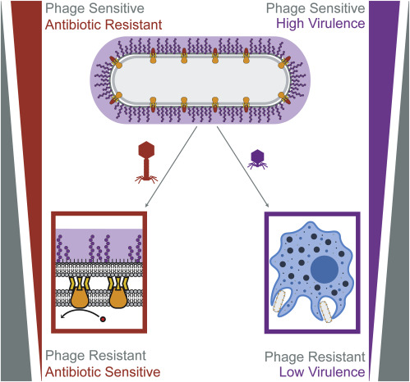
What happen when bacteria acquire phage resistance ?
Reduce the virulence or the antibiotic resistivity
Antibiotic can be reused in association at lower concentration
Kortright, K. E., Chan, B. K., Koff, J. L. & Turner, P. E. Phage Therapy: A Renewed Approach to Combat Antibiotic-Resistant Bacteria. Cell Host Microbe 25, 219–232 (2019).

